Slide 1
Instructional Framework: Starter

Slide 2
Instructional Framework
Starter
Engagement
Ending
HOW
WHAT
IPG
Core Action 1
Core Action 2
Core Action 3
IPG
Core Action 1
Core Action 2
Core Action 3
IPG
Core Action 1
Core Action 2
Core Action 3

Slide 3
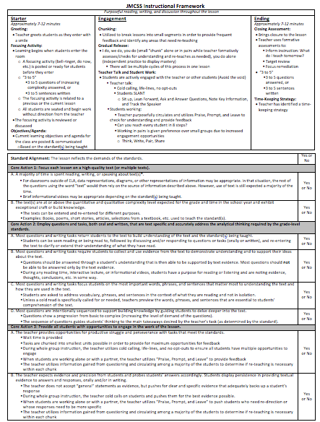
The “How”: Starter, Engagement, Ending
Measuring The “What”:
Core Actions 1, 2, and 3 of the IPG

Slide 5
Starter: Overview
Greeting
Focusing Activity
Objectives and Agenda

Slide 6
Greeting
Teacher greets students as they enter with a smile
Why?
Helps to build relationships
Communicates expectations as students enter the room
Identify any problems or difficult situations with individual students

Slide 7
Greeting
What is your routine for making sure your students are greeted?
What must be done/prepared ahead of time so you are freed up to be able to greet your students?
What are some things that could distract you from greeting your students, and when else could those things be handled?

Slide 8
Focusing Activity
Learning begins when students enter the room
A focusing activity (bell-ringer, do now, etc.) is posted or ready for students before they enter
“3 to 5”
3 to 5 questions of increasing complexity answered, or
3 to 5 sentences written
The focusing activity is related to a previous or the current lesson
All students are seated and begin work without direction from the teacher
The focusing activity is reviewed or discussed

Slide 9
Focusing Activity
Why?
Maximize the use of instructional time (bell-to-bell instruction)
Communicates a sense of urgency
Helps students to transition seamlessly from the hallway and builds positive behaviors and constructive habits by teaching students to transition from “hallway state” to ”learning state”
Reduces variables in a student’s day (students know what is expected of them)
Reduce classroom management issues and enhance relationships by reducing non-positive interactions (“nagging” them to get started) between teachers and students

Slide 10
Focusing Activity
3 to 5 questions of increasing complexity…
If you have questions for students to answer, instead of a writing prompt, it’s important that the questions show a progression of complexity (cognitive demand)
Examples of resources:
Webb’s Depth of Knowledge Charts
Costa’s Levels of Questions
Bloom’s Taxonomy

Slide 11
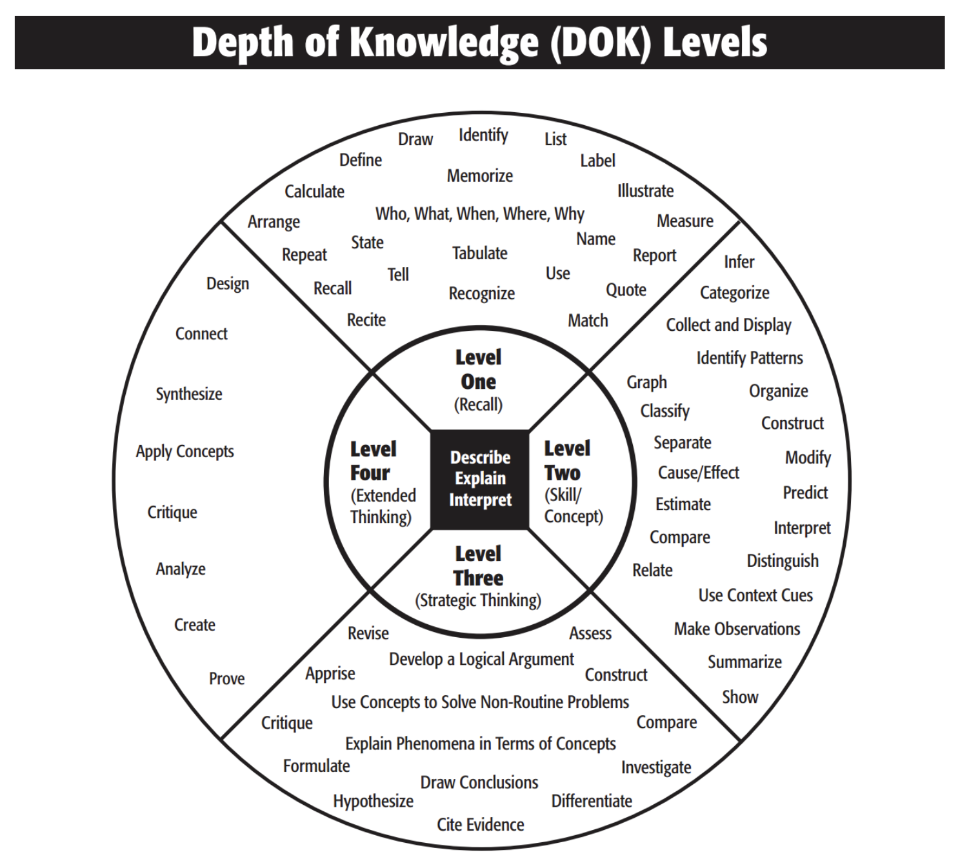
Increasing Complexity of Questions

Slide 12
Focusing Activities in Early Grades
Although focusing activities are intended to be as independent as possible for students, teachers of early grades students will have to make determinations on what will work best for their classes.
Ex:
Questions from the focusing activity might be stated orally by the teacher as students learn to read.
Students might be asked to think about the questions and then share with a partner or the teacher as students learn to write.
No pressure to do this perfectly as we get started!

Slide 13
Morning Work and Focusing Activities in Early Grades
Focusing activities are designed to directly precede instruction on that subject.
“Morning work” can be spiral review, handwriting practice, or other isolated tasks that are independent from the main content of the day’s lesson.
For example, if students come to school and go directly from a classroom to intervention or an activity period, then they might complete “morning work” during or immediately after breakfast.
In this scenario, students wouldn’t complete a focusing activity until the time that immediately precedes the scheduled time for that subject.
Sample schedule:
8:15-8:30
Breakfast and Morning Work
8:30-9:10
Activity Period
9:10-10:40
ELA
The ELA focusing activity would take place at the beginning of this period of instruction

Slide 14
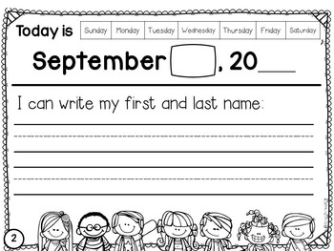
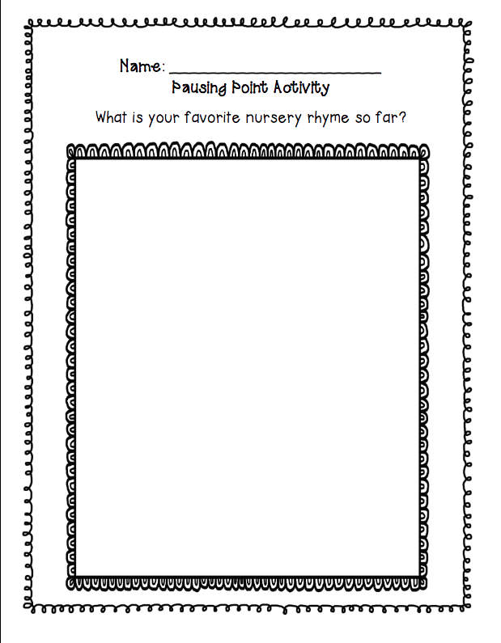
Morning Work and Focusing Activities in Early Grades
Sample Morning Work in Kindergarten
Sample Focusing Activity in Kindergarten (based on CKLA)

Slide 15
Examples of Focusing Activities
1st Grade ELA Example
CKLA Listening and Learning Strand
Domain 9 Lesson 4: The Frog Prince
Vocabulary Word: retrieved
Text in which the word was used during read aloud:
"The princess told her father how the frog had retrieved her ball from the well on the condition that she would be its friend and share everything she had with it forever afterward."

Slide 16
Examples of Focusing Activities
4th Grade Social Studies
Students read an article about Valley Forge during the Revolutionary War.
What was Valley Forge? Where is it located?
Why was it a difficult time for soldiers? Use evidence to support your answer.
Did General Washington inspire the soldiers at Valley Forge? Use at least 2 examples to support your answer.
Notice…
3 questions
Not overly detailed or time-consuming
Based on the current day’s objectives
Questions are text-based
Questions increase in complexity from 1 to 3
Question 1 is explicit and can be found in the text
Question 2 requires comprehension of the text and at least one explicit example from the text
Question 3 requires analysis to find more than one example to support their conclusion

Slide 17
Examples of Focusing Activities
6th Grade ELA Example:
Based on previous day’s reading of Chapter 2 in Hatchet. Refer to your book to answer the following questions:
What does Brian do to save the pilot?
How does Brian determine that the pilot is dead? What evidence supports your answer?
How does Brian know how to use the microphone on the headset? What evidence supports your answer?
What figurative language contributes to the tone of the first 2 pages of this chapter? Use at least 2 examples of figurative language from the text, including context clues that helped you to understand their meaning.
Notice…
4 questions
Not overly detailed or time-consuming
Based on the previous day’s reading
Questions are text-based
Questions increase in complexity from 1 to 4
Question 1 could be explicitly found in the text, with some summarizing required
Questions 2 and 3 require comprehension of the text and citation of evidence
Question 4 requires recognition and understanding of figurative language used, along with analyzing the impact of figurative language on the tone of the passage

Slide 18
Examples of Focusing Activities
9th Grade ELA Example:
Based on previous day’s reading of Act 1 of Romeo and Juliet. Refer to your book and use evidence to support your answers to the following questions:
How are the Capulet servants provoking a fight?
What is the prince’s ultimatum?
What is Benvolio attempting when he says, “Part, fools!”?
What kind of character does Tybalt seem to be?
Notice…
4 questions
Not overly detailed or time-consuming
Based on the previous day’s reading
Questions are text-based
Questions increase in complexity from 1 to 4

Slide 19
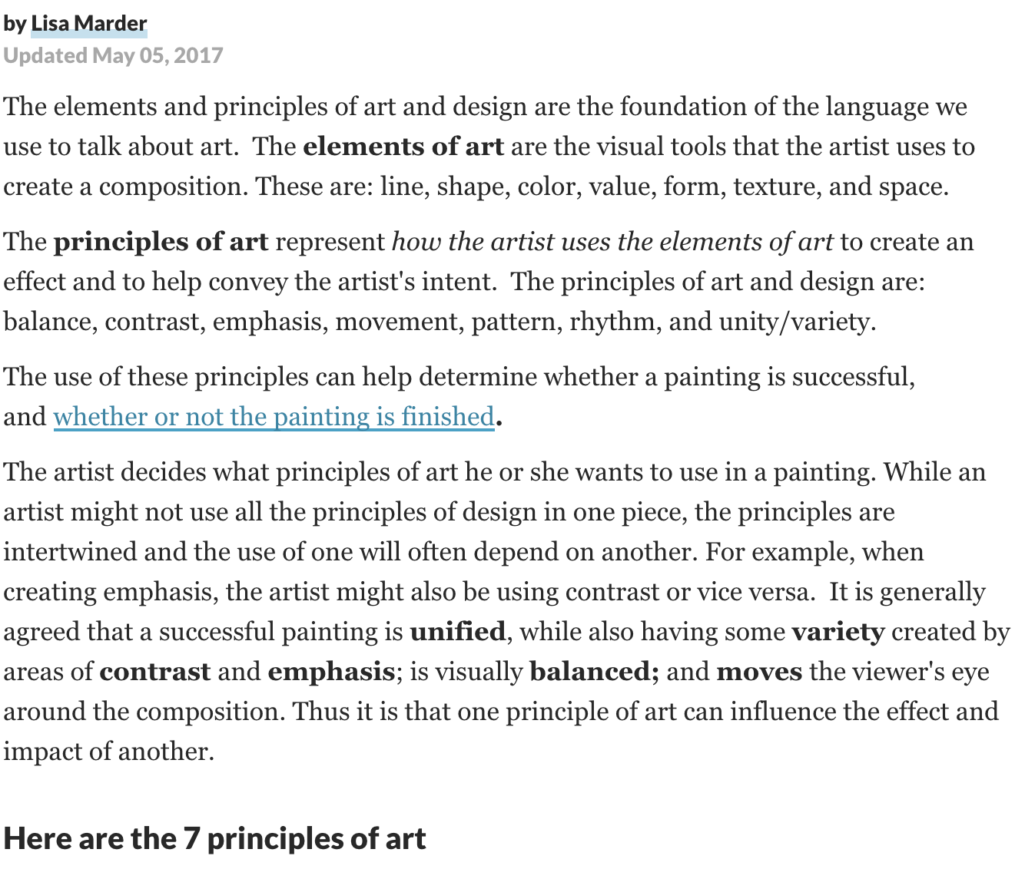
Examples of Focusing Activities
The 7 Principles of Art and Design
Middle School Art
Standard 2.1: Demonstrate an understanding of the elements of art and the principles of design
Based on the article The 7 Principles of Art and Design (excerpt provided).
Identify the elements of art. What are they used for?
Identify the principles of art. What are they used for?
Based on the purposes of the elements and principles of art, how do you plan to incorporate them into your project? Explain why.

Slide 20
Examples of Focusing Activities
High School Anatomy and Physiology
Based on yesterday’s text, respond to the following question in “3 to 5” sentences.
Describe how a neural impulse travels from one neuron to the next. Be specific and cite evidence from the text.
Think first
Wonder next
Predict
Respond

Slide 21
Objectives and Agenda
Current learning objectives and agenda for the class are posted & communicated
Based on the standard(s) being taught
Why?
Define the major “chunks” of your lesson
Students are able to identify the “what” of the lesson
Students know where the class is headed and perceive a structured environment with expectations
Structure fosters a sense of safety and security

Slide 22
Example of Objectives and Agenda
Based off of Expeditionary Learning: Module 1, Unit: 2, Lesson:3
Objectives:
Explain what a text says using quotes from the text.
Make inferences using quotes from the text.
Agenda:
Focusing Activity (related to previous day’s reading of Chapter 3 in Esperanza Rising)
Revisiting Papa’s Death: Close reading of pages 22 – 23
Evaluating and Discussing Challenges to Human Rights in Chapters 2 and 3
Writing about how characters respond to challenges
Lesson debrief
Exit ticket
Each of the following would be considered different “chunks” of the lesson and make up a majority of the time spent in the lesson.

Slide 23
Instructional Framework Feedback
Remember, it’s all about coaching!
The more coaching conversations we have about instruction, the more instruction will improve.
We owe you feedback to help you grow as a professional.
Our students deserve to attend schools where professionals are reflective about their own practices and open to feedback.
This includes teachers, principals, support staff…everyone.

Slide 24
How would feedback be determined if a walk-through happened during a focusing activity?
Since it is during the “Starter,” that is the section of the lesson that would be looked at.
“How”
Then the IPG indicators would be looked at to determine the quality of the focusing activity.
“What”
1
2
3

Slide 25
Instructional Framework Feedback
6th Grade ELA Example:
Based on previous day’s reading of Chapter 2 in Hatchet. Refer to your book to answer the following questions:
What does Brian do to save the pilot?
How does Brian determine that the pilot is dead? What evidence supports your answer?
How does Brian know how to use the microphone on the headset? What evidence supports your answer?
What figurative language contributes to the tone of the first 2 pages of this chapter? Use at least 2 examples of figurative language from the text, including context clues that helped you to understand their meaning.
Does what I see/hear mostly align with this or not?
Were there missed opportunities?

Slide 26
Instructional Framework Feedback
Core Action 3: Provide all students with opportunities to engage in the work of the lesson.
The teacher provides opportunities for productive struggle and perseverance with tasks that meet the standards.
Wait time is provided
Tasks are chunked into smallest units possible in order to provide for maximum opportunities for feedback
During whole group instruction, the teacher utilizes cold calling, life-lines, and no opt-outs to ensure all students have multiple opportunities to engage
When students are working alone or with a partner, the teacher utilizes “Praise, Prompt, and Leave” to provide feedback
The teacher utilizes information gained from questioning and circulating among a majority of the students to determine if re-teaching is necessary within each chunk
?
The teacher expects evidence and precision from students and probes students’ answers accordingly. Students display persistence in providing textual evidence to answers and responses, orally and/or in writing.
The teacher does not accept “general” statements as evidence, but pushes for clear and specific evidence that adequately backs up a student’s response
During whole group instruction, the teacher cold calls on students and pushes them for the best evidence possible.
When students are working alone or with a partner, the teacher utilizes “Praise, Prompt, and Leave” to push students who need re-direction or whose responses need to be more specific
The teacher utilizes information gained from questioning and circulating among a majority of the students to determine if re-teaching is necessary within each chunk
?
Core Action 2: Employ questions and tasks, both oral and written, that are text specific and accurately address the analytical thinking required by the grade-level standards.
Most questions and writing tasks return students to the text to build understanding of the text and the standard(s) being taught Yes!
Most questions and writing tasks require students to collect and use evidence from the text to demonstrate understanding and to support their ideas about the text.
Questions should be answered through a student’s understanding that is then able to be supported by text evidence. Most questions should not be able to be answered only by the text evidence.
During any reading time, interactive lecture, or informational videos, students have a purpose for reading or listening and are noting evidence, thoughts, conclusions, etc. in some way. Yes!
Most questions and writing tasks focus students on the most important words, phrases, and sentences that matter most to understanding the text and how they are used in the text.
Students are asked to address vocabulary, phrases, and sentences in the context of what they are reading and not in isolation.
Unless a cold read is specifically called for or needed, teachers preview the words, phrases, and sentences that are essential to students’ comprehension of the text. Yes!
Most questions are intentionally sequenced to support building knowledge by guiding students to delve deeper into the text.
Questions show a progression from basic to complex (increasing the level of demand of the questions).
The sequence of questions guides students’ thinking to the main takeaways desired by the teacher’s task (as determined by the standard).
Yes!
Core Action 1: Focus each lesson on a high-quality text (or multiple texts).
A majority of time is spent reading, writing, or speaking about text(s)*.
For classrooms outside of ELA, data representations, diagrams, or other representations of information may be appropriate. In that situation, the rest of the questions using the word “text” would then rely on the source of information described above. However, use of text is still expected a majority of the time.
Brief informational videos may be appropriate depending on the standard(s) being taught.
Yes!
B. The text(s) are at or above the quantitative and qualitative complexity level expected for the grade and time in the school year and exhibit exceptional craft or build knowledge.
The texts can be entered and re-entered for different purposes.
Examples: Books, poems, short stories, articles, selections from a textbook, etc. used to teach the standard(s).
Yes!
Standard Alignment: The lesson reflects the demands of the standards
Yes or No?
6.RL.KID.1 Analyze what a text says explicitly and draw logical inferences; cite textual evidence to support conclusions.
6.RL.KID.3 Describe how the plot of a story or drama unfolds, as well as how the characters respond or change as the plot moves toward a resolution.
6.RL.CS.4 Determine the meaning of words and phrases as they are used in a text, including figurative and connotative meanings; analyze the impact of specific word choices on meaning and tone, including allusions to other texts.
Yes!
Yes
Yes
6th Grade ELA Example:
Based on previous day’s reading of Chapter 2 in Hatchet. Refer to your book to answer the following questions:
What does Brian do to save the pilot?
How does Brian determine that the pilot is dead? What evidence supports your answer?
How does Brian know how to use the microphone on the headset? What evidence supports your answer?
What figurative language contributes to the tone of the first 2 pages of this chapter? Use at least 2 examples of figurative language from the text, including context clues that helped you to understand their meaning.
Yes
Yes
Yes
Yes
Yes
Dependent on teacher actions in the room…did strategies such as “Praise, Prompt, and Leave” occur?

Slide 27
Starter: Recap
Greeting
Focusing Activity
Objectives and Agenda

